Slide 1
Azure Synapse Analytics
By using Olympics Tokyo data

Slide 2
Problem Statement – Use Case
Understand the Tokyo Olympics data
Process the Tokyo Olympics final data using Azure Synapse Tool
Analyse the Olympics data to produce meaningful insights and create metrics in the PowerBI tool
Implement using Dedicated SQL Pool

Slide 3
Action Plan and Approach
Olympics data is updated every minute
Solution to handle the large volume and variety of data
Big data solutions are the way to go
Charts and Metrics to be refreshed every minute for Medal Insights
Plan is to use Azure Synapse Analytics by implementing this solution using Dedicated SQL Pool and Spark Pool

Slide 4
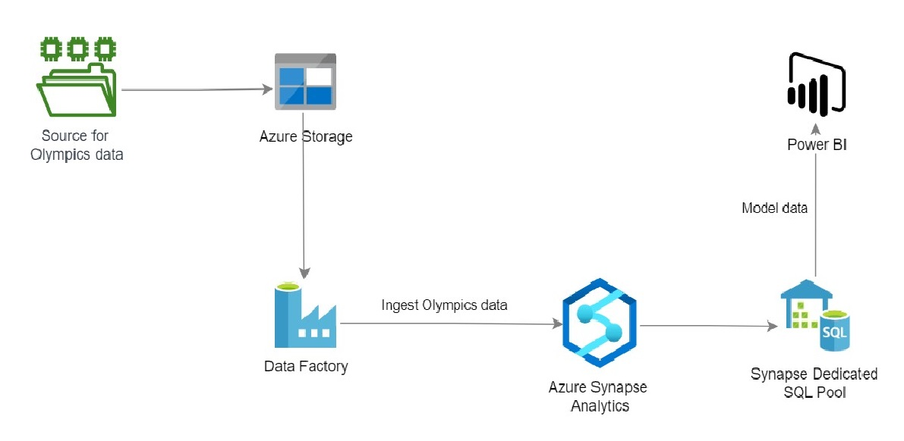
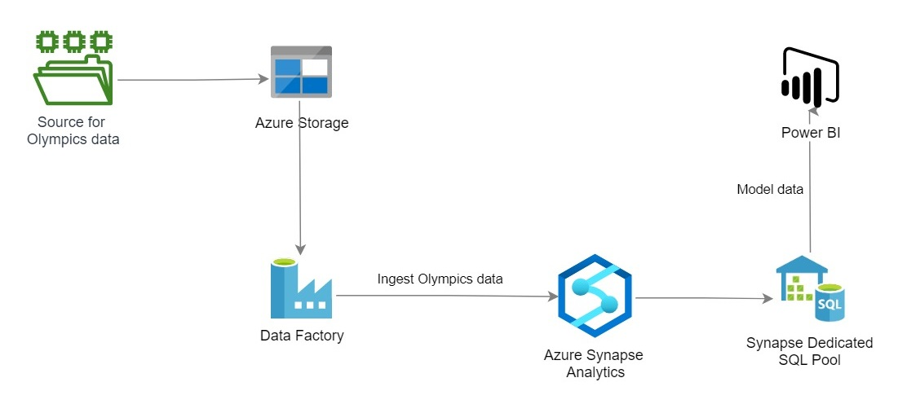
Solution Architecture – SQL Pool

Slide 5
Dedicated SQL Pool vs Serverless Pool vs Spark Pool
Dedicated SQL Pool
Formerly known as Azure SQL DW
Provides Compute and Storage
Serverless Pool
Provides only Compute, there is no Storage
Cannot access data in Dedicated SQL Pool
Storage space is provided by Azure Storage so it can scale independently from the compute cluster
You will not be charged for compute when it is paused but have to pay for Storage
DWU sets the amount of CPU, memory and I/O used by the cluster
Generally used to query data in other places such as
Spark Pool
Lets you use Spark to query the structured and un-structured data
You can pause the SQL Pool
CSV, Parquet and JSON files available in Azure Storage
External tables in Azure Storage created by Spark Pools
You only have to pay for the amount of data processed by your queries
Automatically created by Azure Synapse Workspace
Depending on the need, it can auto-scale by removing and adding nodes
Supports multiple languages like C#, Scala, PySpark, Python and Spark SQL
Mainly used for processing your data stored in Azure (Delta lake)
Provides in-memory cluster computing
Billing is prorated per minute, whether you are using or not. Shutdown the Spark instance after you have finished using it

Slide 6
Practical Lab – SQL Pool
Practical Implementation using Azure Synapse Dedicated SQL Pool and visualisation using Power BI

